Slide 1

Grazing Lease Royalties
Alberta’s Grazing Lease Framework
Background, Proposed Changes, Rational & Implementation
February 18, 2015

Slide 2
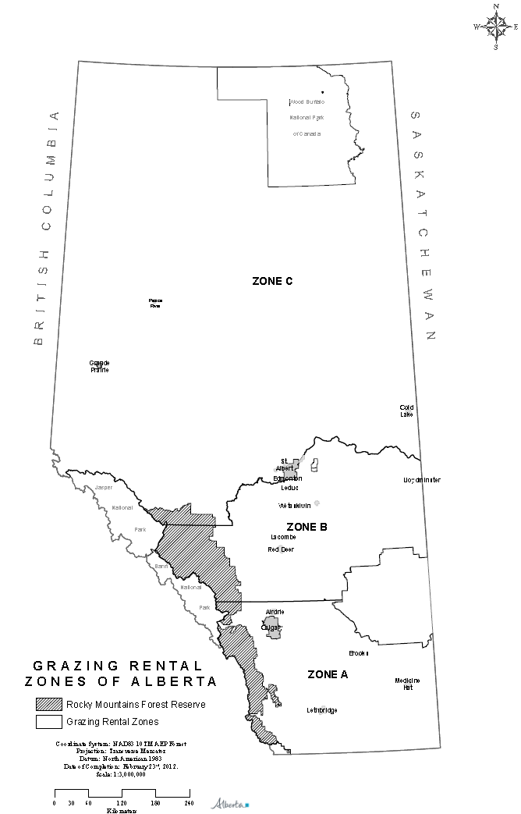
Background –
Rental Rates
3-zone rental rate system implemented in 1960
Based on distance to livestock markets and outdated understanding of forage quality

Slide 3
Background – Rental Rates
Rental rates have been determined using the following formula based on the grazing capacity of the land, the average weight gain of cattle on grass, and the average sale price per pound:
  Rent per AUM = (300lb. wt. gain/AU/yr) x (average lvstk. $/lb) x (zonal %)
12 months
Included a percent that varied by zone – designed to take 5 to 10% of the total revenue derived from grazing on the lease

Slide 4
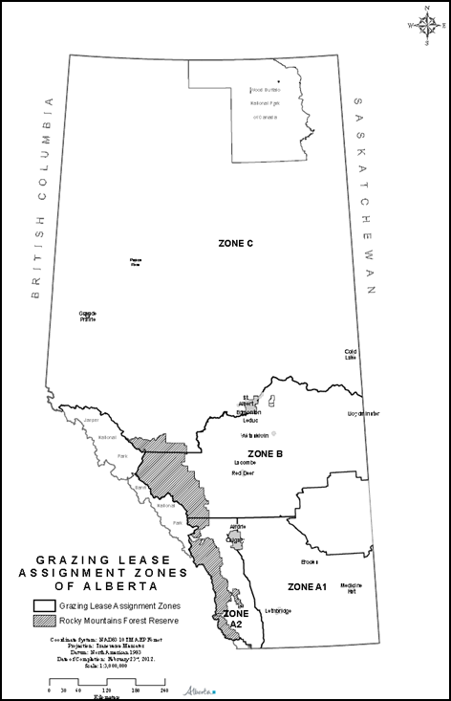
Background – Rental Rates
1994 – grazing rental rates for leases, licences and permits in Alberta were frozen at:
  Zone A (Southern) - $2.79/AUM
  Zone B (Central) - $2.32/AUM
  Zone C (Northern) - $1.39/AUM

Slide 5
Background – Assignment Fees
Established at the same time as rental rates
Designed to capture 50% of the capitalized value of a grazing lease
Fees originally calculated using a formula:
{BPC+(BPC*CPC)+Constant+(BPC*LVC)}*0.5
Where:
BCP – Base Period Consideration
LVC – Land Value Change
CPC – Cattle Price Change
  (varied by Zone – A1, A2, B, C)

Slide 6
Background – Assignment Fees
In 1994 assignment fees were frozen along with rental rates at:
  Zone A1 - $48.53/AUM
  Zone A2 - $99.80/AUM
  Zone B - $48.53/AUM
  Zone C - $3.84/AUM

Slide 7
Background – Assignment Fees
In 2003 assignment fees were incorporated into the Public Lands Act at their current fixed rates along with a minimum assignment fee of $100:
  Zone A1 - $50.00/AUM
  Zone A2 - $100.00/AUM
  Zone B - $50.00/AUM
  Zone C - $5.00/AUM

Slide 8
Review and Proposal Development
Late 2013 ESRD made the decision to review the grazing lease rental rate and assignment system with the intent to implement a new framework
A working group was established with representatives from:
  Alberta Grazing Leaseholders Association
  Alberta Beef Producers
  Western Stock Growers
  Northern Alberta Grazing Association
The committee provided input on the creation of a new framework for grazing rental rates and assignment fees

Slide 9
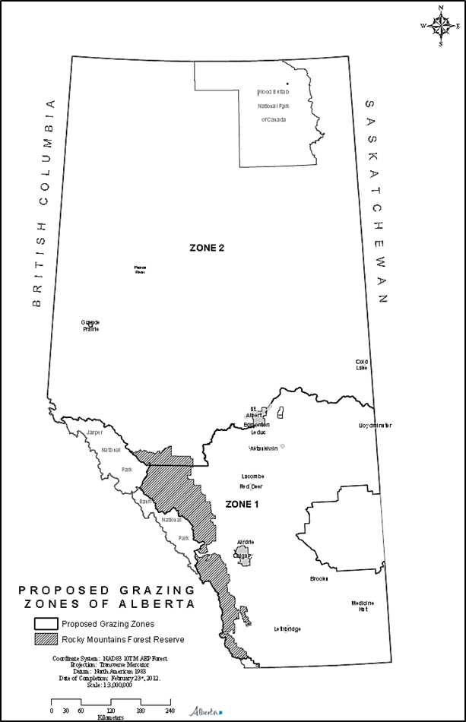
Proposed Grazing Zones
Two zone grazing rental rate structure with a boundary based on the transition to the boreal region of the province
  an area that incurs higher capital costs on grazing leases
The two zones would have different minimum rental rates to reflect these differences in capital costs:
  Zone 1 - $2.30/AUM
  Zone 2 - $1.30/AUM

Slide 11
Proposed Formula
Market-based administrative formula:
  Similar to lumber stumpage, deciduous timber, OSB, pulp and, to some extent, to conventional oil and gas
Minimums when cattle prices are low and no net income is projected:
  Zone 1 Minimum - $2.30
  Zone 2 Minimum - $1.30
When beef prices rise to the point where the industry can earn a profit, 10% of the projected net income from the lease is added to the base as variable rent – this percentage increases as returns to the leaseholder improve

Slide 12
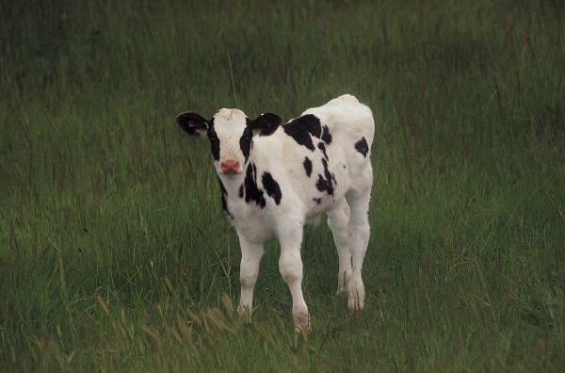
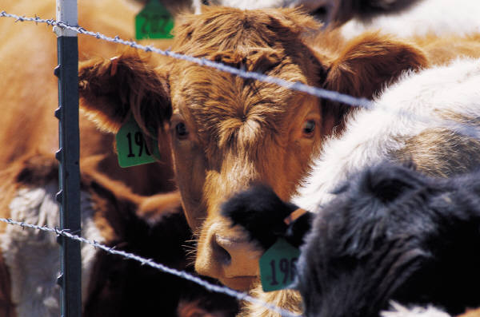
Market-Based Administrative Formula
Grazing Lease Activities
“Output Value”
less “Input Value”
less operating
and labor costs
(2005 cost survey)
“Input Value”: Market Price & Transportation Cost
“Output Value”: Market Price & Transportation Cost
“Residual Income” before “Return to Capital”
Rent is a Portion of “Residual Income”

Slide 13
Rent Based On Yearling Markets
 | Component | Details
1 | Revenue on sale of the yearling | The product of: 2 year average of the prior September Central Alberta yearling price for 800 to 900 lb. steers Expected yearling weight in September (net of transportation weight loss)
2 | (less) Yearling cost | The product of: Prior April Central Alberta yearling price 600 to 700 lb. steers (based on long term relationship) Assumed yearling weight on arriving at the lease – 650 lb. (net of transportation weight loss)
3 | (less) Transportation cost | Cost of trucking the yearling to and from the lease (inflated annually)
4 | (less) Cost while on the grazing lease | Provincial average costs based on the 2005 survey (next slide) Add costs of mortality, vet, sales and minimum rent Costs in place for 10 years (inflated annually)
5 | (equals) “Calculated Net Earnings”

Slide 14
The 2005 Survey – Cost Categories
Item | Direct | Indirect
Capital Costs (20-Year cumulative investment ) | Fence building /rebuilding Range improvement Building/corral construction Road construction Fire protection Dugout development Watering system | Depreciation/amortization Equipment building/corral
Annual Operating Costs | Property taxes Direct labor Supplemental feed costs Road maintenance Building/corral maintenance Fence maintenance Range maintenance Fire protection Multiple use costs | Person years (including farmer /rancher time) Repair and maintenance of buildings, corrals, equipment Fuel costs Utilities costs Insurance costs Interest costs (excluding farmland and residences)

Slide 15
Regional Cost Comparisons (Individual & Association Leases)
Region | Unit Capital Costs ($/AUM/Yr) | Unit Operating Costs ($/AUM/Yr) | Total AUMs | Total # of Grazing Leases
NE | 7.70 | 27.51 | 17,439 | 41
NW | 6.41 | 27.94 | 18,685 | 40
SE | 5.22 | 26.51 | 146,458 | 147
SW | 6.98 | 28.50 | 60,894 | 133
North | 7.04 | 27.73 | 36,124 | 81
South | 5.74 | 27.10 | 207,352 | 280
All Regions | 5.93 | 27.18 | 243,476 | 361

Slide 16
Projected Rental Rates¹ (Ignoring The
Effect Of Phasing In The New Rates)
Year of Rental Rate | 2 Year Rolling Avg. Prior Sept. Beef Price | Zone 1 Rent (851,933 AUMs) | Zone 2 Rent (442,582 AUMs) | Total Paid in $ million (1,294,515 AUMs)
2013 | $1.33 | $2.48 | $1.58 | $2.81
2014 | $1.41 | $3.25 | $2.35 | $3.81
2015 | $1.77 | $6.82 | $5.98 | $8.46
2016 | $2.15 | $10.43 | $9.63 | $13.15
2017 | $2.03 | $8.19 | $7.39 | $10.25
2018 | $1.75 | $5.96 | $5.11 | $7.34
2019 | $1.58 | $4.36 | $3.51 | $5.27
2020 | $1.38 | $3.34 | $2.44 | $3.93
2021 | $1.18 | $2.33 | $1.43 | $2.62
2022 | $1.05 | $2.30 | $1.30 | $2.53
¹Apart from the “2 Year Rolling Average Prior September Beef Prices” for 2013, 2014 and 2015, these values are hypothetical and intended only to illustrate a possible range in rents expected under the formula ignoring the phase in provisions.

Slide 17
Phased Implementation
Grazing lease rental rate changes will be phased in over a five year period (2017-2021)
Rental rates will be calculated as the base rate plus an annually increasing percentage of the premium beyond the base rate
If there is a crossover in rental rates during the phased implementation rental rates will default to the full rates
In the following example, a crossover in rental rates occurs in 2019

Slide 18
Zone 1 Projected Phased Rental Rates¹
Year of Rental Rate | 2 Year Rolling Avg. Prior Sept. Beef Price | Variable Rent (Total Rent Less Minimum) | Phased Variable Rent (% Shown x Full Variable Rent) |  | Actual Zone 1 Total Rent (Including Phase In) | Total Zone 1 Rent in $ million (851,933 AUM)
2013 | $1.33 | $0.18 | n/a | n/a | n/a | n/a
2014 | $1.41 | $0.95 | n/a | n/a | n/a | n/a
2015 | $1.77 | $4.52 | n/a | n/a | n/a | n/a
2016 | $2.15 | $8.13 | 20% | $1.63 | $3.93 | $3.34
2017 | $2.03 | $5.89 | 40% | $2.36 | $4.66 | $3.97
2018 | $1.75 | $3.66 | 60% | $2.20 | $4.50 | $3.83
2019 | $1.58 | $2.06 | 80% 100% | $1.65 $2.06 | $3.95 $4.36 | $3.36 $3.72
2020 | $1.38 | $1.04 | 100% | $1.04 | $3.34 | $2.85
2021 | $1.18 | $0.03 | 100% | $0.03 | $2.33 | $1.99
2022 | $1.05 | $ - | 100% | $ - | $2.30 | $1.96
¹Again, apart from the “2 Year Rolling Average Prior September Beef Prices” for 2013, 2014 and 2015, these values are hypothetical and intended only to illustrate a possible range in rents expected under the formula. The application of the phased variable rent would be eliminated when the current year’s full variable rent is less than the prior year’s partial or phased premium – in this example that occurs in 2019.

Slide 19
Zone 2 Projected Phased Rental Rates¹
Year of Rental Rate | 2 Year Rolling Avg. Prior Sept. Beef Price | Variable Rent (Total Rent Less Minimum) | Phased Variable Rent (% Shown x Full Variable Rent) |  | Actual Zone 2 Total Rent (Including Phase In) | Total Zone 2 Rent in $ million (442,582 AUM)
2013 | $1.33 | $0.28 | n/a | n/a | n/a | n/a
2014 | $1.41 | $1.05 | n/a | n/a | n/a | n/a
2015 | $1.77 | $4.68 | n/a | n/a | n/a | n/a
2016 | $2.15 | $8.33 | 20% | $1.67 | $2.97 | $1.31
2017 | $2.03 | $6.09 | 40% | $2.44 | $3.74 | $1.65
2018 | $1.75 | $3.81 | 60% | $2.29 | $3.59 | $1.59
2019 | $1.58 | $2.21 | 80% 100% | $1.77 $2.21 | $3.07 $3.51 | $1.36 $1.55
2020 | $1.38 | $1.14 | 100% | $1.14 | $2.44 | $1.08
2021 | $1.18 | $0.13 | 100% | $0.13 | $1.43 | $0.63
2022 | $1.05 | $ - | 100% | $ - | $1.30 | $0.58
¹Again, apart from the “2 Year Rolling Average Prior September Beef Prices” for 2013, 2014 and 2015, these values are hypothetical and intended only to illustrate a possible range in rents expected under the formula. The application of the phased variable rent would be eliminated when the current year’s full variable rent is less than the prior year’s partial or phased premium – in this example that occurs in 2019.

Slide 20
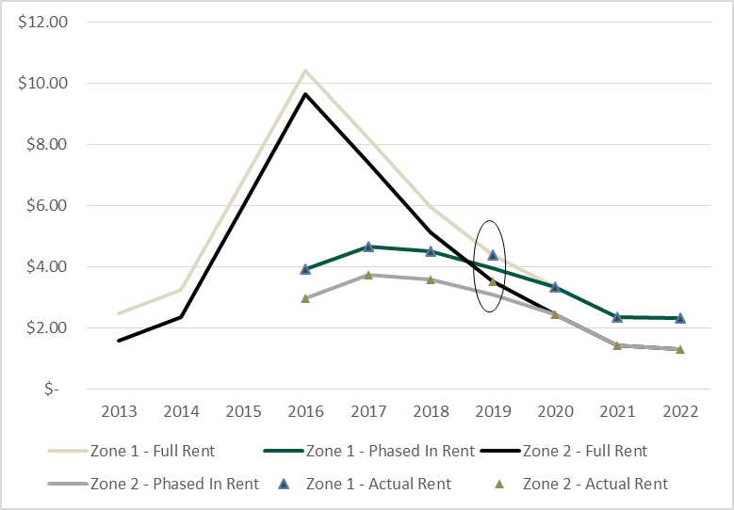
Projected Phased Rental Rates
Crossover

Slide 21
Rental Rates 20 Year Comparison

Slide 22
Assignment Fees
Assignment fees will be a flat rate throughout the province that reflects the cost of administration
Not based on a per AUM fee

Slide 23
Range Sustainability Fund
Range Sustainability Fund contributions would be 40% of the rental rate and would apply to minimum rents as well as any increased rents
The department would use the fund to partner with groups such as: Cows and Fish, Rocky Mountain Forest Range Association, Alberta Beef Producers, Alberta Grazing Leaseholders Association, Western Stockgrowers, Alberta Native Plant Council, Southwest Alberta Sustainable Community Initiative, etc.
Funding recommendations would come from an industry advisory committee

Slide 24
Range Sustainability Fund
Dollars would be used to fund rangeland sustainability initiatives including:
  Stewardship enhancement
  Education and awareness
  Ecosystem goods and services research
  Climate change adaptation
  Invasive species
  Impacts and mitigation of recreational use
  Projects aimed to gain a better understanding of the current pressures on rangelands

Slide 25
Formula Review
A review of the system will be undertaken in 5 years to ensure that industry is comfortable with the new formula and zones
Government agrees to resurvey costs periodically (every 10 years) to ensure that formula is reasonable and based on current costs

Slide 26
Questions
Market Based Rents for Grazing Leases

Slide 27
Appendix – Summary Information On the Proposed Calculation of Rents and on Assignment Fees
Market Based Rents for Grazing Leases

Slide 28
List of Objectives – Developed with Stakeholder Committee
Have comparable methodology to other resource sectors
Support the maintenance of native grasslands and recognize the interconnections between public and private grasslands
Recognize the contributions of good management and private capital to the system
Be fair to both leaseholders and government
Be defendable to economic threats
Promote and encourage good stewardship
Remove existing barriers to succession or entry into the industry that result from the current rental rate formula or assignment fee schedule
Be justifiable - to the Alberta public, other provinces and other resource sectors
  Must also be justifiable to grazing lease holders – with rental rates applied fairly across the province based on geographical cost differences

Slide 29
Proposed Rental Rate Formula
Formula is:
Yearling cattle market value
Less Additional input costs
Less Lease operating costs
Times A predetermined %
Plus The minimum rent
Equals Grazing lease rental rate

Slide 30
Grazing Lease Rents – Summary of Changes
Current Rental Rates | Proposed Rental Rates
Rental rate revenue has remained ~$2.9M since the formula has been frozen. | Rental rate revenue would, on average, be maintained or increased. Minimum rental rate revenue would be ~$2.5M when cattle prices are depressed and rental rates are at their minimums
Rental rate formula not aligned with other provincial royalty systems. | Proposed rental rate formula aligned with timber stumpage, deciduous timber, OSB and pulp, conventional oil and gas and oil sands royalties.
Rental rate formula calculated using: Weight gain of cattle. Average price of cattle. Zone percentages (based on grazing zones). | Rental rate formula calculated using: Market value of cattle. Input, investment and operating costs of disposition holder (Grazing Lease Cost Study).
Three grazing zones with separate rates and zonal royalties: Zone A = $2.79/AUM (rent); 10% (royalty) Zone B = $2.32/AUM (rent); 8^{1/3} % (royalty) Zone C = $1.39/AUM (rent); 5% (royalty) Originally designed to account for longer distance to market faced by northern producers and to encourage settlement of northern Alberta. Different charges per AUM in the grazing zones. Zonal royalties are fixed for each grazing zone. | Elimination of three grazing zones and replacement with a two zone system that captures minimum rental rate of $2.30/AUM in Zone 1 and $1.30/AUM in Zone 2 with incremental royalties increasing as profits increase: ↑ cattle prices = ↑ royalties ↓ cattle prices = ↓ royalties (to $2.30 or $1.30/AUM) Distance to market no longer applicable. Incremental royalties are responsive to market conditions and equal across the Province.
Rental rates have been frozen since 1994. Lacks transparency (both formula and frozen fees). Not based on relevant cost structures incurred by leaseholder. Unresponsive to market conditions (frozen fees). | Proposed rental rate formula applies a two zone formula that would be calculated each year. Transparent and defendable. Based on relevant cost structures incurred by leaseholders (cost study). Responsive to market conditions.

Slide 31
Assignment Fees – Summary of Changes
Current Assignment Fees | Proposed Assignment Fees
Assignment fees were designed to recover 50% of the capitalized value of a disposition resulting from such factors as grazing rights and rental rates. | Proposed assignment fees will cover the administrative costs of registering the assignment.
Assignment fee charged based on carrying capacity of land: $ /AUM | Administrative cost not based on carrying capacity.
These fees were originally calculated using a formula approach: {BPC + (BPC*CPC) + Constant + (BPC*LVC)}*0.5 BCP – Base Period Consideration CPC – Cattle Price Change LVC – Land Value Considers: Percentage change in cattle prices. Percentage change in grazing land values in four zones. Base period consideration. | Fee that reflects the actual administrative cost of registering the assignment.
Assignment fees calculated using the “Formula Approach” were frozen in 1994: Zone A1 = $48.53/AUM Zone A2 = $99.80/AUM Zone B = $48.53/AUM Zone C = $3.84/AUM | Elimination of assignment fee zones.
In 2003, assignment fees for “Arms-Length Transfers” incorporated into Public Lands Act at the following fixed rates: Zone A1 = $50/AUM Zone A2 = $100/AUM Zone B = $50/AUM Zone C = $5/AUM Five other assignment types were established in 2003 under the Act with a flat $100 assignment fee charge. | Elimination of assignment fee zones and incorporation of assignment fees into the Public Lands Administration Regulation Elimination of different categories of assignments.
Assignment fees are not transparent: Based on outdated and cumbersome “Formula Approach”. Not consistent across province Dependent on a variety of transfer types. Not reflective of the cost of assigning the disposition. | Assignment fees would be transparent: Not based on a cumbersome formula. Applied consistently across the province. Not differentiated by transfer types. Based on administrative costs to register the assignment.

