Slide 1
Recreational Access History
(from Oct. 2007 Wildlands Advocate)
The access controversy seems to have begun in 1973 when a private member’s bill was introduced in Alberta’s legislature proposing to give grazing leaseholders the right to refuse access to the public. Bill did not pass.
1980 the Director of the Public Lands Division advised leaseholders that “a grazing lessee is entitled to rely on Sec. 41 of the criminal code to use as much force as is necessary to remove a trespasser.”
1981 - Assistant Deputy Minister of Fish and Wildlife controversially stated that “common law dictates that grazing leases are considered ‘real property,’ and that under common law, a leaseholder may launch civil trespass actions against those who enter land leased for grazing without permission.”
Notes:
From Wildlands Advocate October 2007 Private member’s Bill did not pass

Slide 2
Recreational Access History
1983 – Use Respect Program
1985 - Alberta Cattle Commission (ACC) and the Western Stock Growers’ Association asked the government to change the Trespass Act to comply with the criminal code in order to give landowners and leaseholders absolute right over access
1987 - Public Lands Grazing Lease Conversion Task Force formed. Recommended foot and vehicle access to grazing leases be allowed without permission at all times (vehicles restricted to established roads or designated trails)

Slide 3
Recreational Access History
1989 - George Alexson was charged with trespassing for hunting without permission on land leased for grazing. The court ruled that Alexson was not guilty. Appealed: Guilty. Further Appealed: Not Guilty
1995 - Public lands access was challenged in court again in OH Ranch Ltd. v. Wade T. Patton. Court ruled in the ranch’s favour and the appeal that followed was lost
In 2003, after thirty years of controversy, the Agricultural Dispositions Statutes Amendment Act legislated that recreational users must obtain permission before entering leased land
2006 - Recreational Access Regulation – those entering leased land without permission would be issued simple fines rather than required to make a court appearance. (AMP)

Slide 4
CAPP / Cowboy Committee
1999 - 2003
Started as Grazing Lease Review Committee pre Thurber Report
CAPP joined conversation after Agriculture Dispositions Amendment Act 1999
No Lines in Sand Allowed – to wit Alta Surface Rights Federation
Notes:
Maybe we should have drawn line at unequivocal leaseholder control of access
Even OH v Patton included a comment from Judge that change may be needed

Slide 5
And Also From Wildlands Advocate
“Ranchers have saved our bacon with respect to conserving native prairie,” says Dr. Mark Brigham, biology professor at the University of Regina and member of COSEWIC (Committee on the Status of Endangered Wildlife in Canada). “Hats off to them. We have relatively little native prairie left, and unlike many other habitats, once it’s gone we cannot get it back. We don’t know how to restore it.”

Slide 6
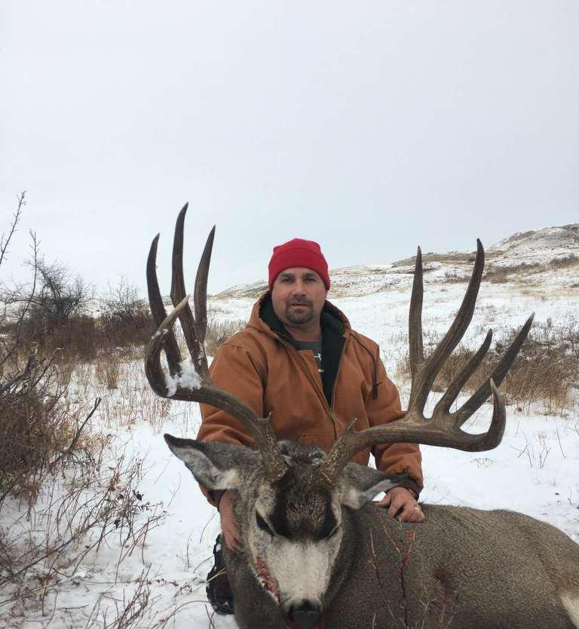
New Technologies Since 2003
Technologies mean that hunters know well in advance of the season where the trophies are. If they are on your lease you can expect a lot of calls
Notes:
Picture was texted to me and now you are looking at it technology!
Nowhere near my place – probably taken somewhere in S America!

Slide 7
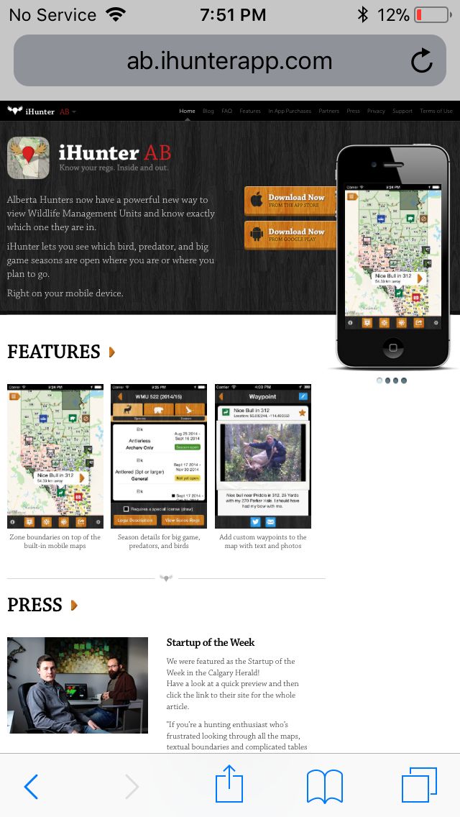
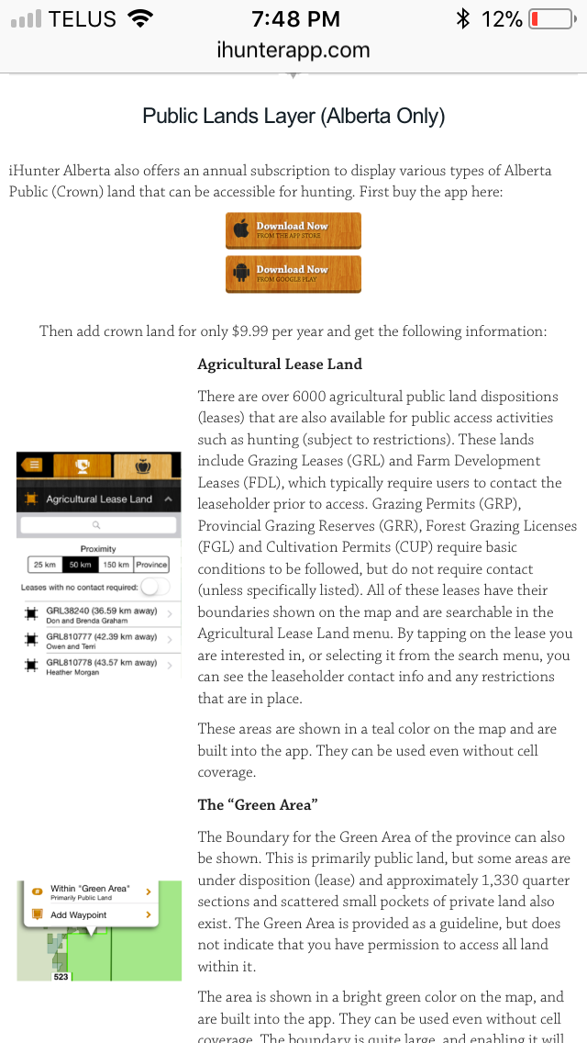
Notes:
New technologies on rec access users side
Subscription apps with basic info like seasons, sunrise sunset, and add ons like Public Lands Layer, GPS

Slide 8
New Attitude
To whom this may concern,
I am wishing to gain access to your grazing lease land GRL33180 and GRL35318 which is located north of Pincher Creek & Highway 3 and east of the Oldman Reservoir. I have a mule deer buck draw license for WMU305 and will be exclusively hunting a mule deer buck. I am very respectful of land and land/lease holders. I will be on foot only and keep my vehicle on the established roadways. I drive a 4-door grey in colour 2003 Jeep Grand Cherokee SUV. I will be hunting solo. I plan on hunting from Oct. 25 - Oct. 30.
I look forward to your reply. Thanks,
Notes:
October 23rd

Slide 9
New Attitude – cont’d
Your request for access to both of our grazing leases is denied because of the very high fire hazard.
Respectfully
Bill Newton
Notes:
October 23rd

Slide 10
New Attitude – cont’d
Hello Mr. Newton,
As a lease holder that is not a valid reason to deny me access to public land when their is no provincial or local fire ban on. Lease holders do not get to determine the risk of fires on public land, the government does. I have been granted permission on several other grazing leases near yours.
I understand and respect farmers need to protect their agriculture and livestock but in this case if you have no livestock on those leases and I am on foot you can’t deny me my reasonable request to access public land.
I suggest you review the Alberta Public Lands Act, I have attached the link below.
http://aep.alberta.ca/recreation-public-use/recreation-on-agricultural-public- land/default.aspx
I have CC’ed into this e-mail Mr. Edward Evenson, the local Lands Officer, to settle this dispute.
Mr. Evenson can you please comment.
Notes:
October 24th

Slide 11
New Attitude – cont’d
There is currently a Fire Ban in effect for the MD of Willow Creek the fire ban has been effect since October 18, 2017, GRL33180 and GRL35318 are located within this MD. Under section 6 of the Recreational Access Regulations the lease holder may deny access to the grazing lease when a fire ban is in place. Below is the link to the Alberta fire bans website please monitor this when the fire ban is lifted you can again request permission for access.
https://albertafirebans.ca/
Thank you
Edward. R. EVENSON
Notes:
October 27th
Leaseholders don’t know anything
Disrespectful uninformed access users are invited to again request permission
Is the municipality or the province the appropriate level of jurisdiction for the fire ban decision – local decision making tools are now available

Slide 12
Issues
Increasing demand
New Attitude
Enforcement
“Public Land”
Liability
Wildlife Act
Escalating Conflict
Notes:
AGLA newsletter has picture of the discarded cigarette butt from rec user last fall

Slide 13
Potential Solutions
Technology ?
Dedicated e-mail address with LSO approved rec access capacity
Outsource Contact and Security Service (third party)
Application Fee
Rec Access User Ranking System
EGS Marketplace (paid access)
GoA act as the gatekeeper?
Rec Access Users act as the gatekeeper?
Increase Trespass Penalties

Slide 14
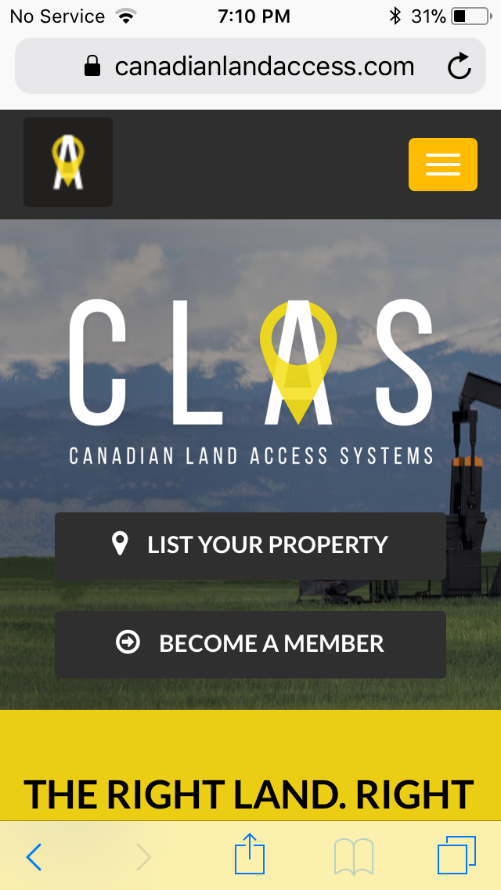
New Technologies Since 2003
Notes:
Landowner pays for sign
Rec Access users pay subscription - $30 for one month up to $70 for one year
Paid hunting?
No revenue to Landowner / Lessee

Slide 15
Alberta Wildlife Act
Disposition of access to land
49(1) No person shall directly or indirectly buy or sell, trade or barter or offer to buy or sell access to any land for the purpose of hunting any big game or any fur-bearing animals on any land.
(2) No person shall directly or indirectly buy or sell, trade or barter or offer to buy or sell access to any land for the purpose of hunting any game bird except as provided in subsection (3).
RSA 2000 Section 50 Chapter W-10
Notes:
SubSection 3 allows sale , barter, trade for upland game bird as long as person holds a license under the Act for that purpose – and only on private land.
Define “directly or indirectly buy, sell, trade or barter”? If a GoA decision maker asks permission e.g. NRCB, AER
What about NCC appraisal officer? What about whiskey?

Slide 16
No Place Left To Hunt
The precipitous drop in the number of hunters is apparently alarming the Alberta government – so much so that it has taken the unusual step of declaring an annual Alberta Hunting Day, beginning this year. Why has this drop in hunter numbers occurred? Could it be linked to the new legal requirement that those accessing White Area grazing leases must gain prior permission from the leaseholder?
We put this question to Bob Scammell, a retired lawyer and outdoors writer with a long-time interest in public lands. He points out that various surveys have asked former hunters why they have stopped hunting. “The universal answer is ‘because there is no place left to hunt,’” he says.
Notes:
Seems Like a good argument for an EGS marketplace

